Slide 1

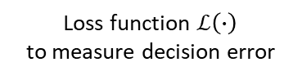
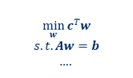
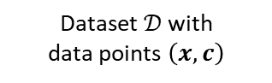
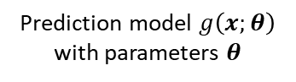

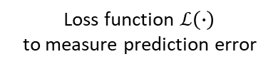
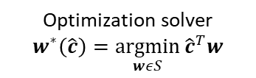
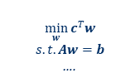

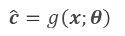
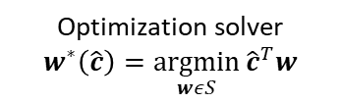
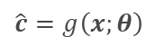
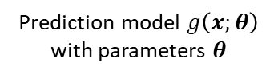

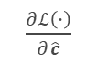
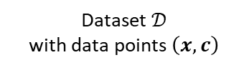
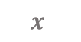
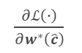
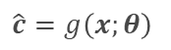
$$x$$
$$\hat{c}=g\left(x;θ\right)$$
$$\min_{w}{c^{T}w}$$
$$s.t. Aw=b$$
….
$$w^{∗}\left(\hat{c}\right)$$
$\frac{∂ℒ\left(∙\right)}{∂\hat{c}}$
$\frac{∂ℒ\left(∙\right)}{∂w^{∗}\left(\hat{c}\right)}$
Dataset $𝒟$ with
data points $\left(x,c\right)$
Prediction model $g\left(x;θ\right)$
with parameters $θ$
Optimization solver
$$w^{∗}\left(\hat{c}\right)=\underset{wεS}{argmin}{{\hat{c}}^{T}w}$$
Loss function $ℒ\left(∙\right)$
to measure decision error
Dataset $𝒟$
with data points $\left(x,c\right)$
Prediction model $g\left(x;θ\right)$
with parameters $θ$
Loss function $ℒ\left(∙\right)$
to measure prediction error
$$x$$
$$\hat{c}=g\left(x;θ\right)$$
$\frac{∂ℒ\left(∙\right)}{∂\hat{c}}$
Test Time
$$\hat{c}=g\left(x;θ\right)$$
$$\min_{w}{c^{T}w}$$
$$s.t. Aw=b$$
….
Optimization solver
$$w^{∗}\left(\hat{c}\right)=\underset{wεS}{argmin}{{\hat{c}}^{T}w}$$

Slide 2
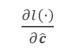
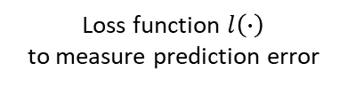

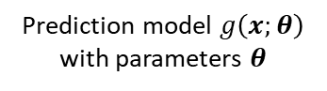
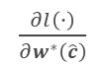
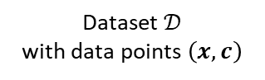
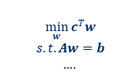


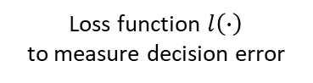
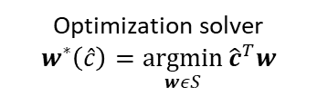
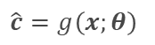
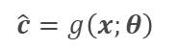
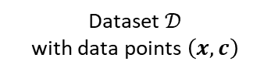
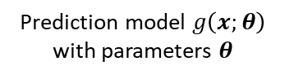
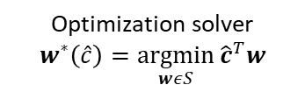

$$x$$
$$\hat{c}=g\left(x;θ\right)$$
$$\min_{w}{c^{T}w}$$
$$s.t. Aw=b$$
….
$$w^{∗}\left(\hat{c}\right)$$
$\frac{∂l\left(∙\right)}{∂\hat{c}}$
$\frac{∂l\left(∙\right)}{∂w^{∗}\left(\hat{c}\right)}$
Dataset $𝒟$
with data points $\left(x,c\right)$
Prediction model $g\left(x;θ\right)$
with parameters $θ$
Optimization solver
$$w^{∗}\left(\hat{c}\right)=\underset{wεS}{argmin}{{\hat{c}}^{T}w}$$
Loss function $l\left(∙\right)$
to measure decision error
Dataset $𝒟$
with data points $\left(x,c\right)$
Prediction model $g\left(x;θ\right)$
with parameters $θ$
Loss function $l\left(∙\right)$
to measure prediction error
$$x$$
$$\hat{c}=g\left(x;θ\right)$$
prediction error feedback
Test Time
$$\hat{c}=g\left(x;θ\right)$$
$$\min_{w}{c^{T}w}$$
$$s.t. Aw=b$$
….
Optimization solver
$$w^{∗}\left(\hat{c}\right)=\underset{wεS}{argmin}{{\hat{c}}^{T}w}$$

